Slide 1


Slide 2

:
TEAM MEEMBERS
Masood Raisani
Maryam Ahmad Rana Aftab Ashraf
Laiba Ashiq Rafaqat Ali
01
02
03
04
05

Slide 3
Topic:
P-N Junction Operation, Ions Formation
Mechanism of barrier Layer
Presented to: Miss Ayesha Malik

Slide 4
Pn Junction Diode
P-N Junction:
When a P type semiconductuction Crytal is brought
Into close contact with an n-type semiconductor
Crystal, the resulting arrangement is called a
P-N junction.
Diffusion Current:
Flow of charge in semiconductor travels from
higher concentration to a lower concentration

Slide 5
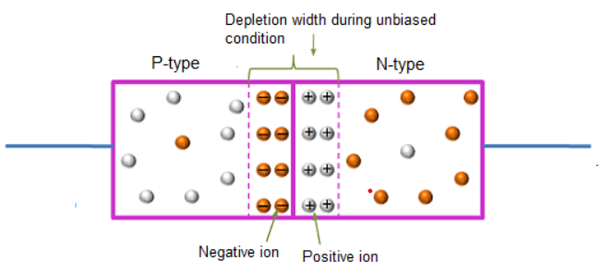
Structure of p-n junction:

Slide 6
Doping process of p-n junction:
Doping is the process adding impurities to
intrinsic semiconductor to alter their properties.
Normally trivalent and pentavalent are used to dope
Silicon and Germanium.
Trivalent:
An atom which contain only three valance electron.
Pentavalent:
An atom which contain only five valance electron.

Slide 7
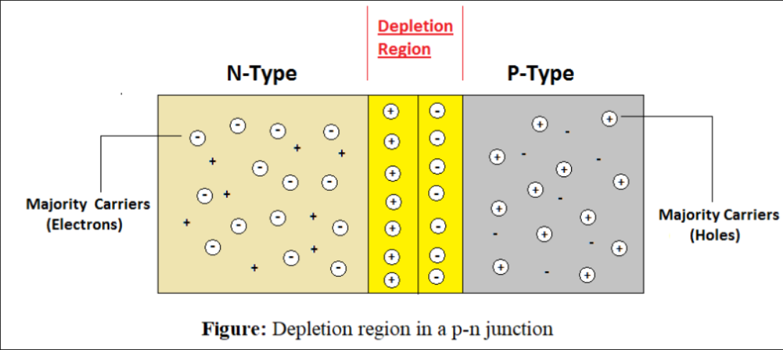
Depletion region:
Depletion Region:
The region around the junction is called depletion region.
Formation of depletion region:
After the formation of the junction, the free electrons
In the N-region diffuse into the P-region where these
Electrons combine with the holes in the first layer
Of the P-region and A chargeless region is produced.

Slide 8
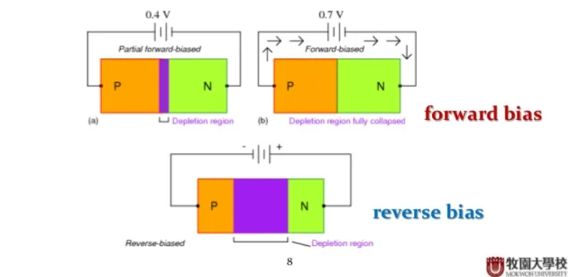
Dependence of depletion region:
Temperature:
Width of depletion region decrease with increasing temperature
Forward biased:
Width of depletion region decrease when diode is forward biased
Reversed biased:
Width of depletion region increase when diode is reversed biased

Slide 9
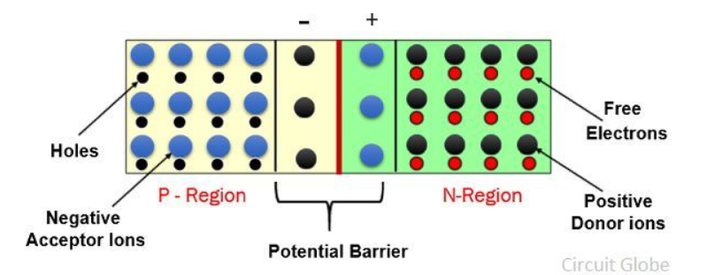
Potential barrier:
Define:
Due to combining of electron hole pair the ion on both
Sides are exposed and they form a potential difference
This is called a potential barrier.
0.7 for Silicon
0.3 for Germanium
Prevent further diffusion of electron.
Charge required additional force to cross the potential barrier.

Slide 10
forward baise and reversed baise:
Forword Biased:
A junction is said to be forward biased when external potential
Difference is applied across P-N junction in such a way that
P –side is connected to positive terminal and N side to negative
Terminal of the battery
It passes a few milli ampere
Reversed biased:
In reverse biased P- type is connect to the negative terminal
And N-type is connected to the positive terminal of the battery
It passes few micro amperes
Potential barrier increase
Resistance becomes very high

Slide 11
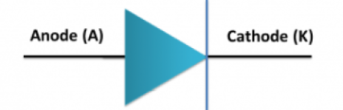
Semiconductor diodes:
Semiconductor diode:
P-N junction is known as semiconductor diodes
Symbolic Representation is.
Arrow head represent the P- region and it is also called Anode.
Vertical line represent the N- region and it is also called cathode.

Slide 12
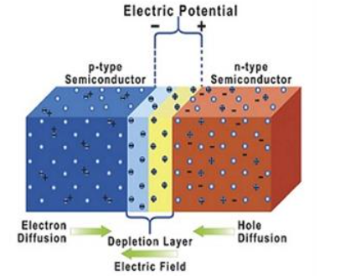
ions formation in p-n junction:
The donor impurity in the n-type semiconductor loses an electron and becomes a positive ion. The acceptor impurity in the p-type accepts this electron, forming a negative ion.
Diffusion:
Electron diffuse in P- region and left positive ions in N- region
Recombination:
Electron combine with holes and form negative ion in P-region

Slide 13
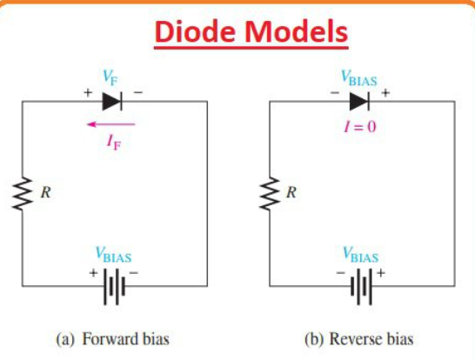
Direction of current in p-n junction:
Direction of current:
Outstanding property is that it conduct current only in one direction
It conduct current in forward biased.
It doesn't conduct current in reverse biased
resistance is very high width of depletion
region is very large.

Slide 14
Application of p-n junction:
Application of p-n junction is given below
Solar Cells:
It is used as a solar cell. Solar energy into electric energy.
LED Lighting:
It can be used in LED lightning when it is forward biased.
Rectifier:
It is used as a rectifier in many electronic circuits to convert AC
Into DC.
Voltage controlled oscillator:
It is used as a voltage controlled oscillator.

Slide 15
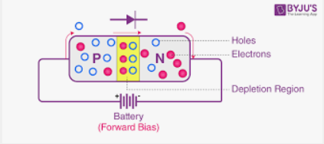
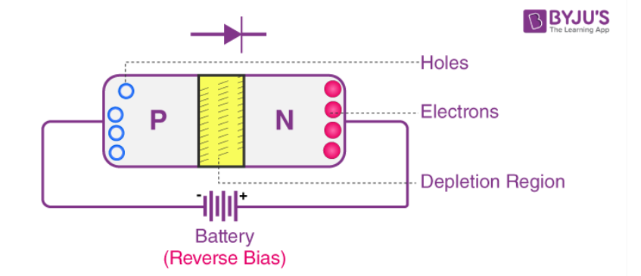
Difference b/w forward & reversed biased:
Forward biased: Reversed Biased:
P-type is positive at higher potential N-type is positive at higher potential
N-type is positive at higher potential P-type is positive at higher potential
Current can flow Current can not flow.
Diode will behave as on switch Diode will behave as off switch.
Depletion region is very thin Depletion region is thick.
P-N junction offers very low resistance P-N junction offers very low resistance.
Diagram: Diagram:

Slide 16
.
ANY QUESTION ?

Slide 17


